Slide 1
Amazon Echo Dot 2 Disassembly
Kyle Mahoney, January 2018

Slide 2
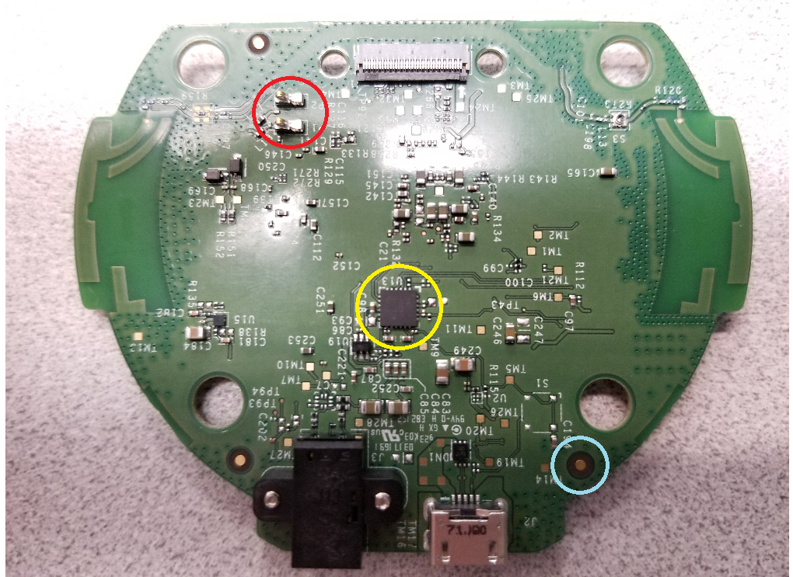
Circuit Board 1 Top Components
Notes:
Red = spring clips connected to speaker; yellow = DAC; blue = copper antennas

Slide 3
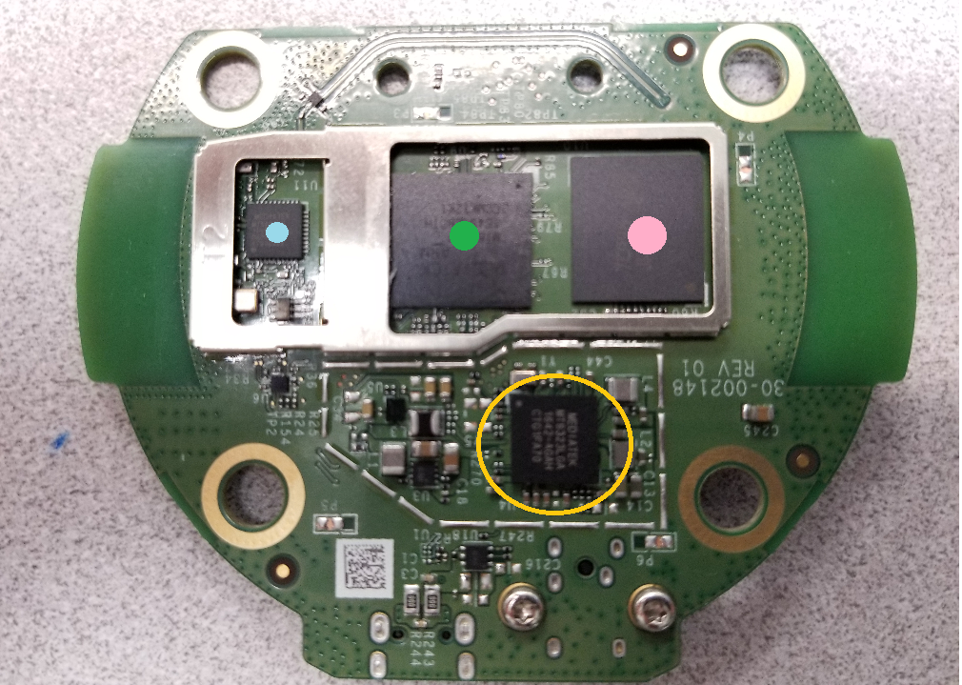
Circuit Board 1 Bottom Components
Notes:
Pink dot = memory; green dot = processor; blue dot = wifi/bluetooth chip; yellow circle = PMIC

Slide 4
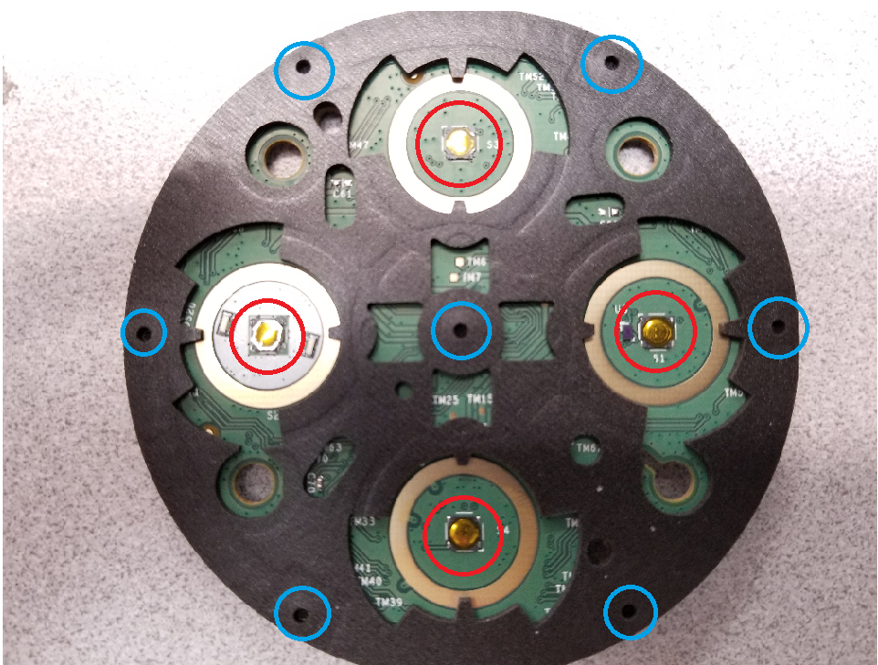
Circuit Board 2 Top Components
Notes:
Red = tactile switches; blue = microphone holes

Slide 5
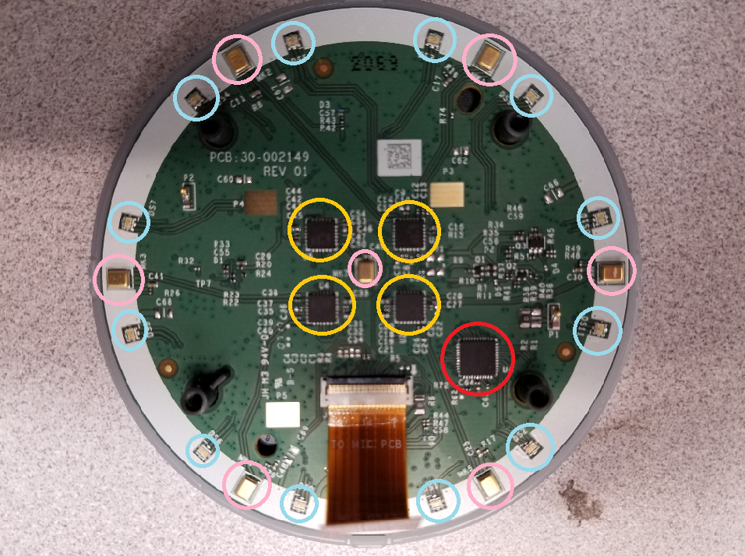
Circuit Board 2 Bottom Components
Notes:
Pink = microphones; blue = LEDs; yellow = ADC; red = microcontroller

Slide 6
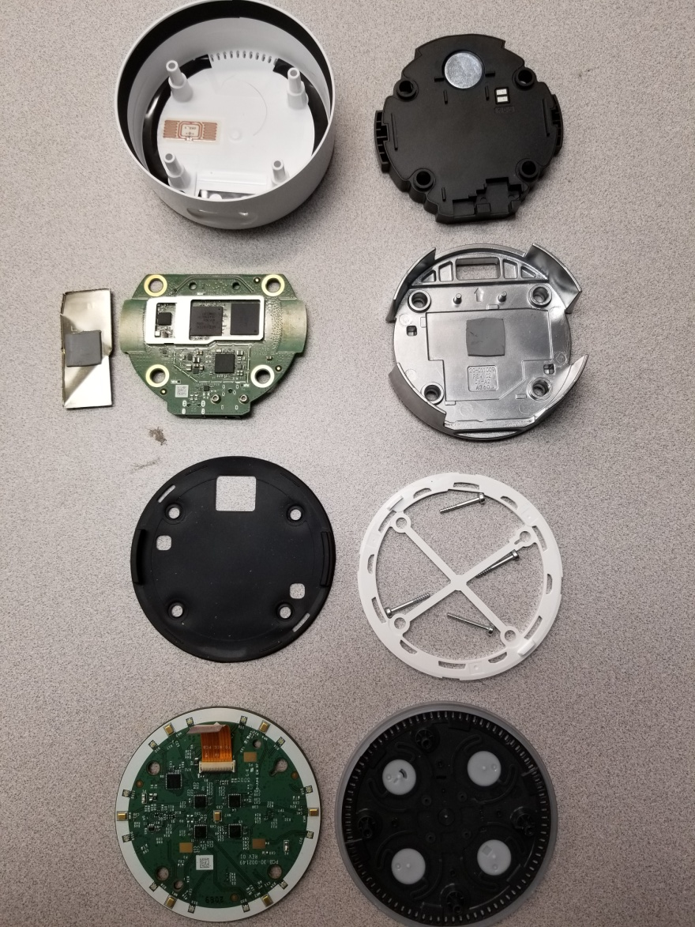
Echo Dot Complete Disassembly

